Slide 1
CWGS
Disaster Recovery Management Tool
Date
Date: 18-5-2022
Date

Slide 2

Why?
The Disaster Recovery not only protects the physical disaster, but it protects the cyber disaster as well. In client/server architecture, the departments (confines with people) create the network of server or desktop machines to get things done. The business unit managers will protect the data, because it is critical for company’s critical assets. If we can’t protect the data, we can not restore the data. So, It is a challenge for an IT company. The batch process technology is very time consuming. The Peter krough, digital photographer invented the 3-2-1 rule as 3 copies of this data(1 primary and 2 backups), 2 on different types of media and 1 in remote location, away from his place of business. If your solution follow this rule will be the key component to success of recovery. The planning and preparation are keys to a successful data protection strategy.
DR plan

Slide 3

User Segment & Pain Points
A disaster recovery software helps the organisation to maintain or quickly resume its mission critical functions after the disaster occurs. It facilitates to prevent the catastrophic events that can significantly damage the server, computer or network. The major disaster recovery function includes:
Data center Disaster Recovery
Cloud Disaster Recovery
Network Disaster Recovery
Virtualised Disaster Recovery
We provide the solutions to the business challenges that can
Minimise downtime
Prevent data loss
Manage and protect workloads
Reduce IT complexity
DR segment

Slide 4
Current Landscape
There are many DR products available in the market which we are going to compete are,
Zerto - Powerful automation facility that can transfer assets and workload between public, private and hybrid cloud
Carbonate - It has custom backup options for multiple items, protection of OS, files and system state
ArcServe - It support recovery time objectives(RTO) is a duration of time and service level within which business process must be restored. It is the downtime a business can tolerate. Recovery point objective (RPO) as measured as a maximum amount of data that can be lost after recovery from disaster, failure or events
Veritas - it is single and scalable solution available on converged platform
Rubrics - it provides asynchronous deduplicated replication across data centre and public cloud as automated disaster recovery.

Slide 5
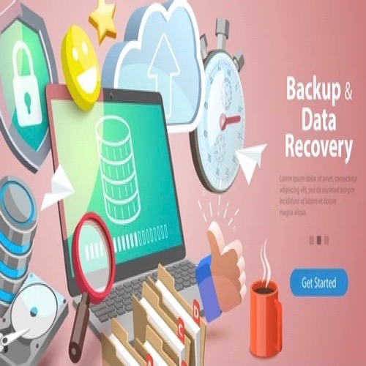
DEMO
Solution:
Our disaster recovery tool will recover to the cloud with more consistent recovery points and this improves greater value in data protection solution. Also, It reduces the risk of unplanned downtime by replicating the critical systems to the cloud. When an outage occurs, users can access the secondary copy with just few clicks.
Methodology:
We build the UI/UX design for the DR tool to recover the data with consistent recovery points using the secondary copy with just a few click in cloud.
Architecture :
We fully understand the key objectives and initiatives surrounding the business unit and conduct the full discovery of all business requirements. So, we need to identify the recovery needs within the budget and the solution. Our staff to be trained properly to meet the objectives of the solution as well.

Slide 6
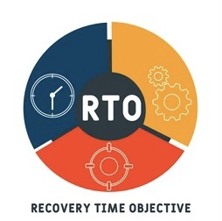
Key Differentiators & Adoption Plan
We have planned to build in the cloud environment for disaster recovery and data protection. We mainly focus to reduce the Recovery Time Objectives (RTO) in the organisation. So, we provide the UI/UX design that will encourage the staff for his DR activity in the organisation.
RTO

Slide 7
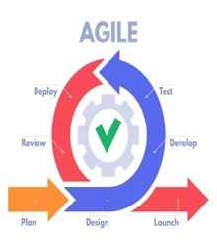
Future Vision
We will develop the product with 3 main features and iterate with new version. Our DR tool will be used in our organisation and other IT peoples in the market as well. We will plan for other iteration based on the requirement and usage of the product as well.
Agile Iteration

Slide 8

Your Aha Moment!
It will be one of the best IT product to be developed and used for business continuity and employee engagement without any downtime in our organisation.

Slide 9
Thank You
Team member names
BALAMURUGAN D
PARTHA BANERJEE

